Slide 1

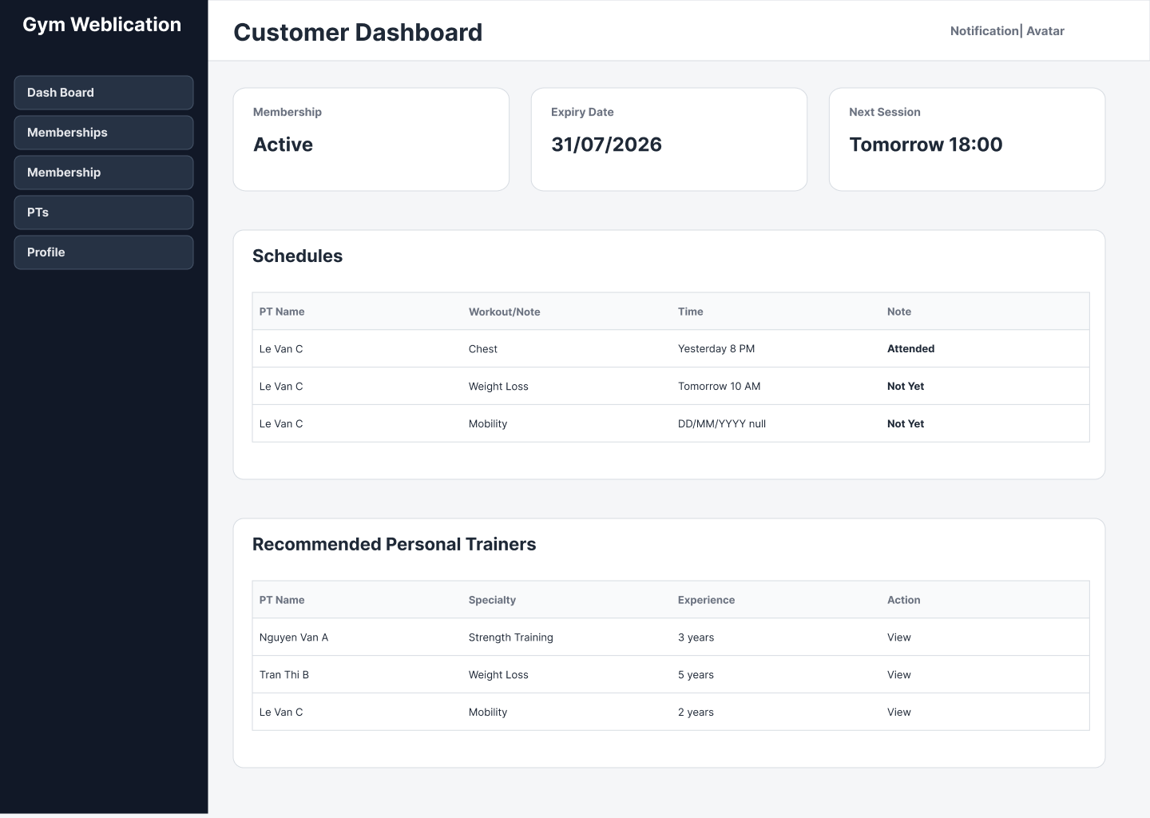
Gym Management
System
BRD Presentation
SWR302 – GROUP 5
Members: Nguyễn Sỹ Minh Mẫn, Trần Đăng Khoa, Bùi Đình Long
Instructor: Trần Chí Viễn
Gym Management System

Slide 2

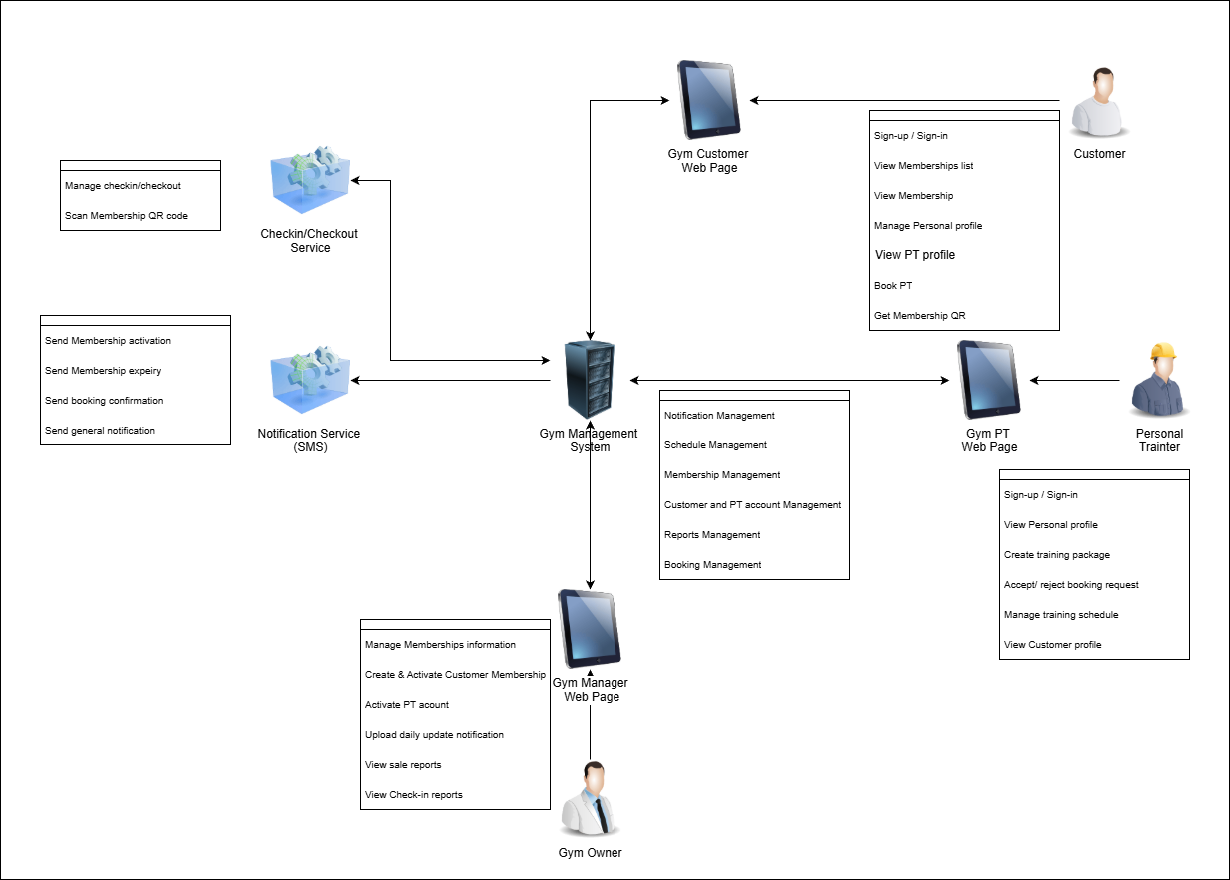
Team Members
Team members and presentation coverage
Main role & sub role
SWR302 BRD – Group 5
SE201643 Bùi Đình Long
BRD Integration
Remaining Sections
SE201631 Nguyễn Sỹ Minh Mẫn
DFD, Data Dictionary
Prototype
SE201635 Trần Đăng Khoa
Use Case Diagram
Use Case Specification
Problem and scope
Actors and use cases
Business processes
DFD and data design
State transitions
Prototype demonstration
Presentation coverage
Gym Management System

Slide 3

Background / Problem Context
Why is this system needed?
Typical gym operations are fragmented across front desk, PT service, check-in, notifications, and reporting.
Membership data is managed manually or inconsistently.
PT booking and training schedules are difficult to track.
Check-in/check-out records are hard to consolidate.
Notifications and reports are not centralized.
Gym Management System

Slide 4
Limitations of the Traditional System
Traditional Process
Problems Caused
Counter-only records
Manual schedule coordination
No reliable visit history
Separated notification channels
Delayed operational reports
Data inconsistency
Missed or conflicting PT sessions
Weak access traceability
Low communication control
Slow business decisions
Main message: automation + centralized data are required
Gym Management System

Slide 5
Project Objectives and Scope
What can the proposed system do?
Scope
Out of Scope
Manage customer and PT accounts.
Register and activate memberships at the counter.
Manage PT packages, booking, and schedules.
Support QR check-in/check-out.
Publish notifications and generate reports.
Online payment processing
Membership renewal, suspension, or cancellation
Payroll, inventory, and equipment management
Mobile application
Advanced prediction or analytics
Customer
Personal Trainer
Gym Owner
Account
Membership
Schedule
Report
Notification
PT Booking
QR Check-in
Gym Management System

Slide 6
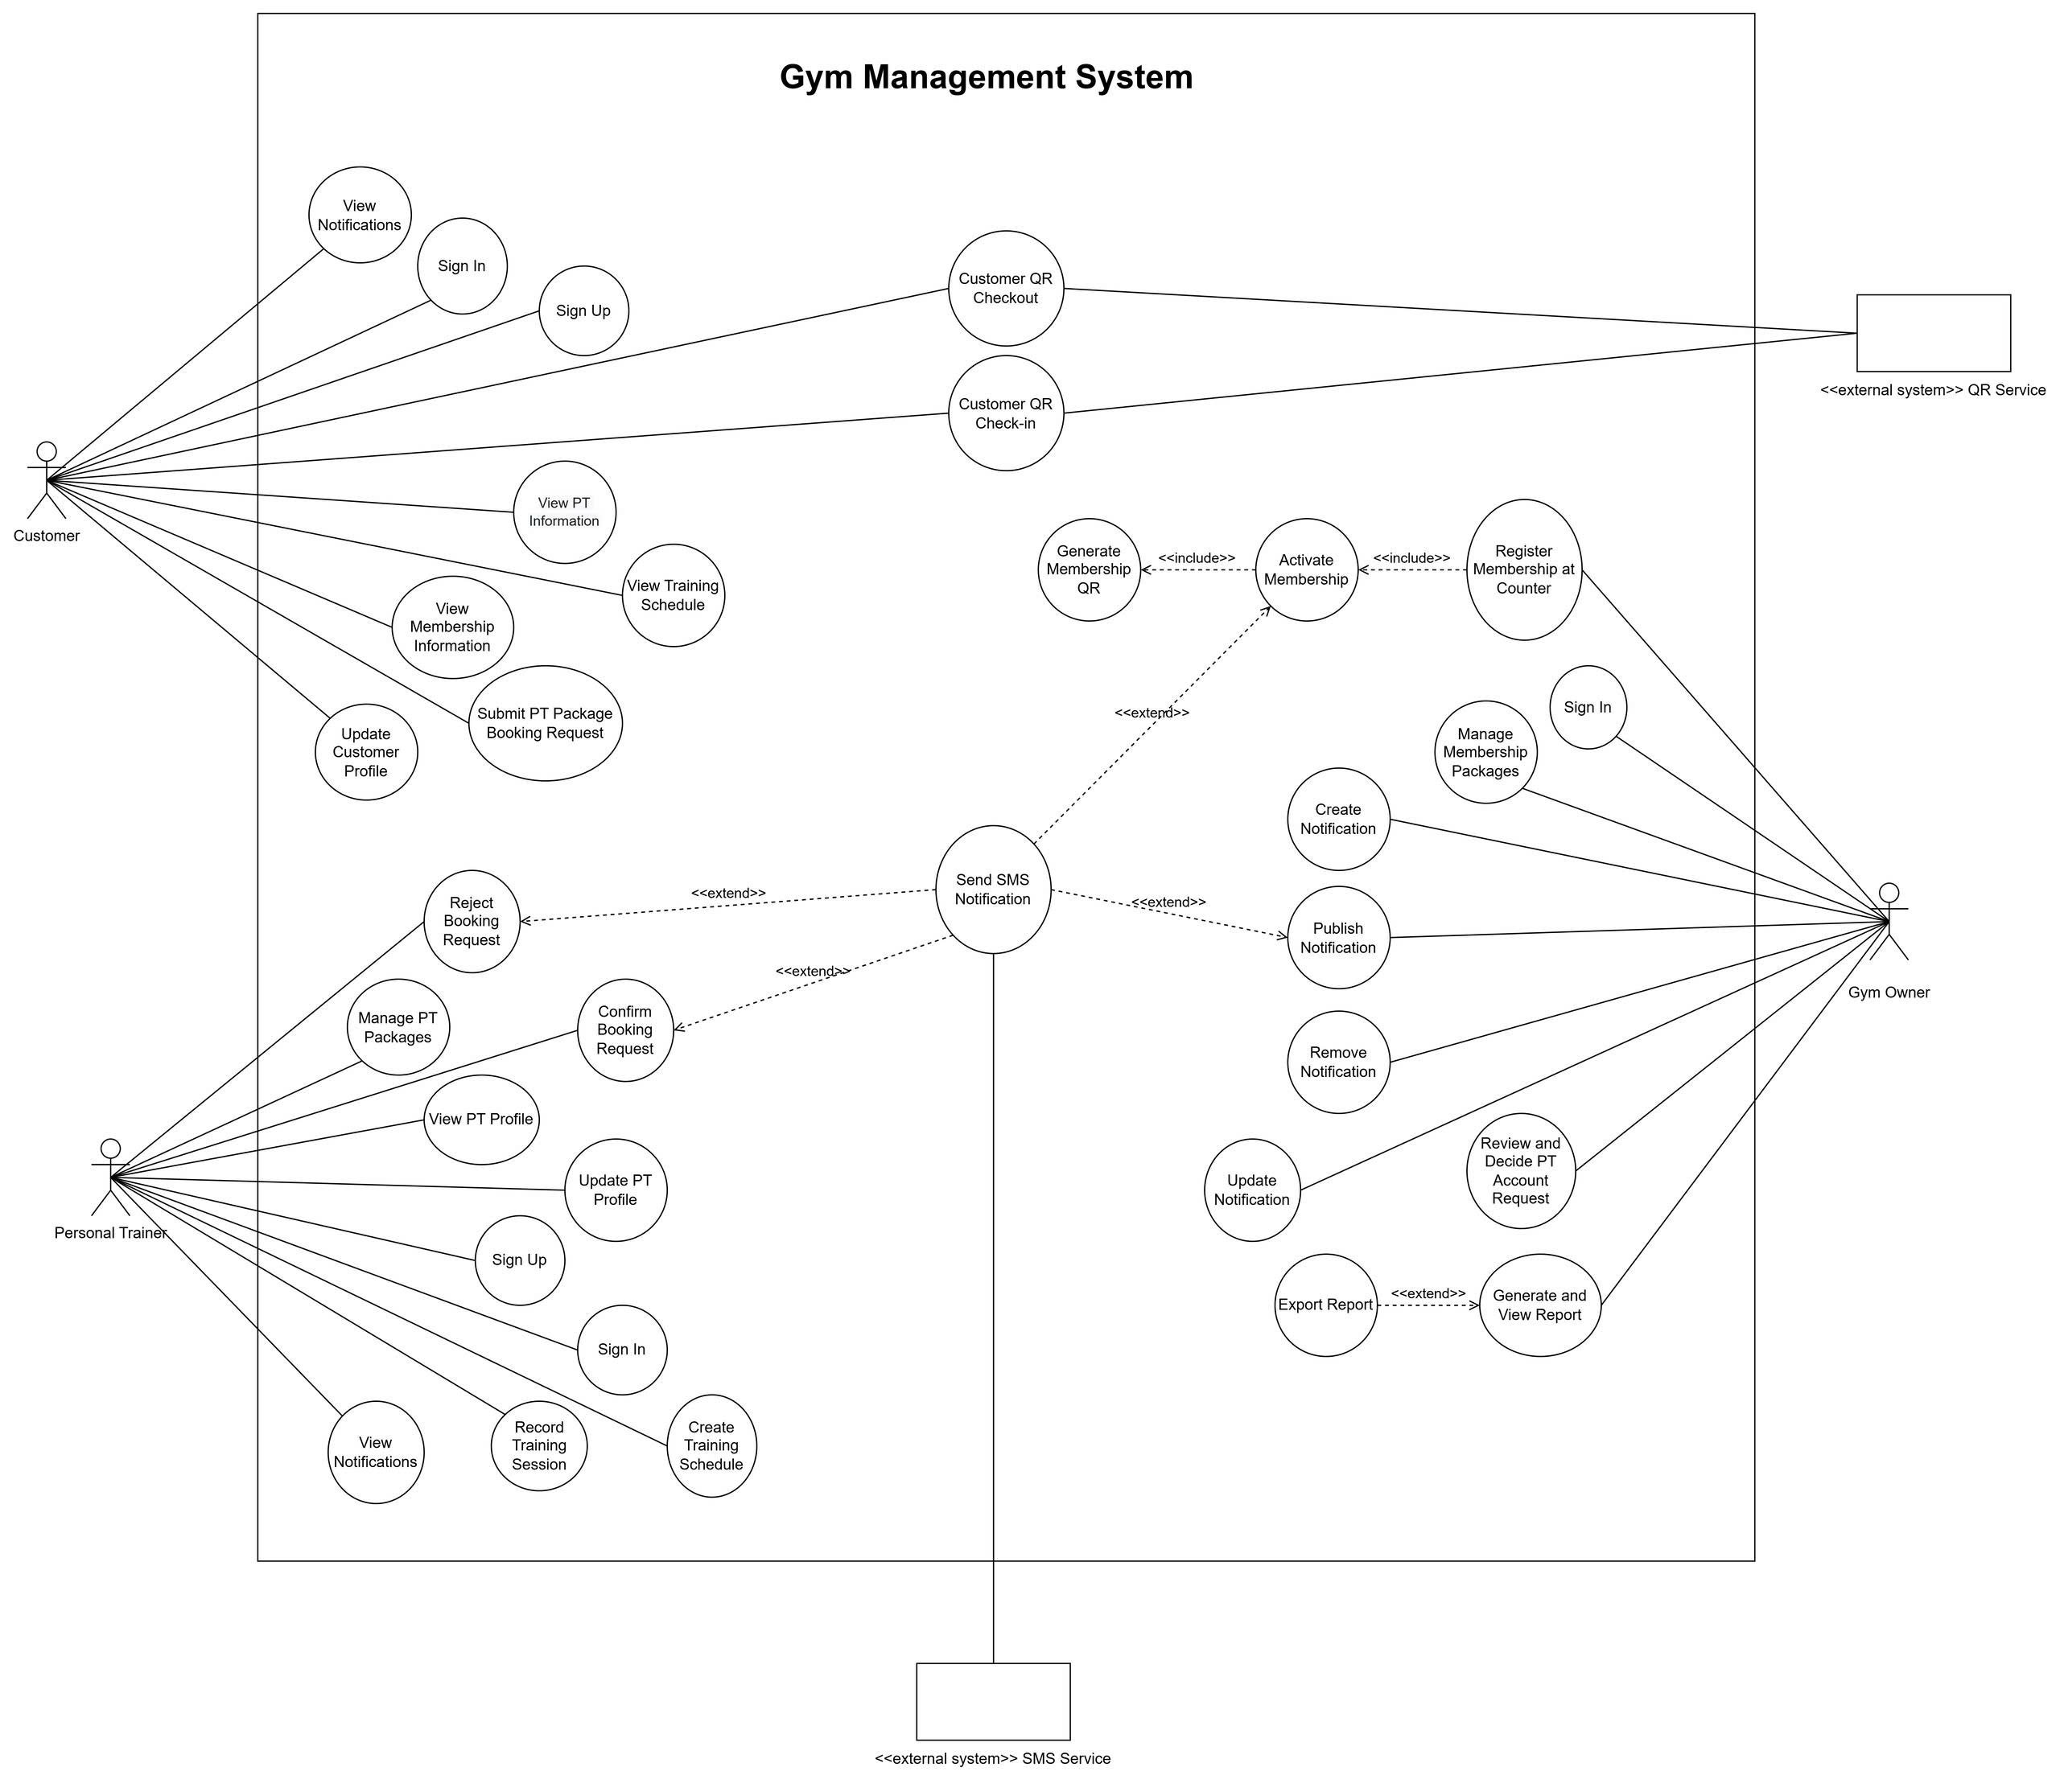
Actors and Main Use Case
Who uses the system?
Customer
Gym Owner
Manage membership
Approve PT account
Publish notification
View/export reports
Sign up/sign in
View membership
Book PT package
View schedule and QR
Personal Trainer
External system
Submit request
Manage profile/package
Accept or reject booking
Record training session
Notification/SMS
QR Scanner
Check-in/out events
Gym Management System

Slide 7
Context Diagram
Main Actors
Customer — account data, membership requests, PT bookings, QR check-in/check-out
Personal Trainer — PT account request, package management, booking response, training schedule
Gym Owner — membership management, PT approval, notifications, reports
Notification/SMS Service — delivers system and SMS notifications
QR Scanner Service — sends QR scan and check-in/check-out data
Main Data Flows
Customer receives membership details, booking results, schedules, QR codes, and notifications
PT receives booking requests, customer information, and schedule data
Gym Owner receives membership records, PT requests, check-in data, and reports
External services exchange notification and access-control data with the system
Key Message
The Context Diagram shows who interacts with the system and what data is exchanged, without describing internal processes or database structure.
Gym Management System

Slide 8
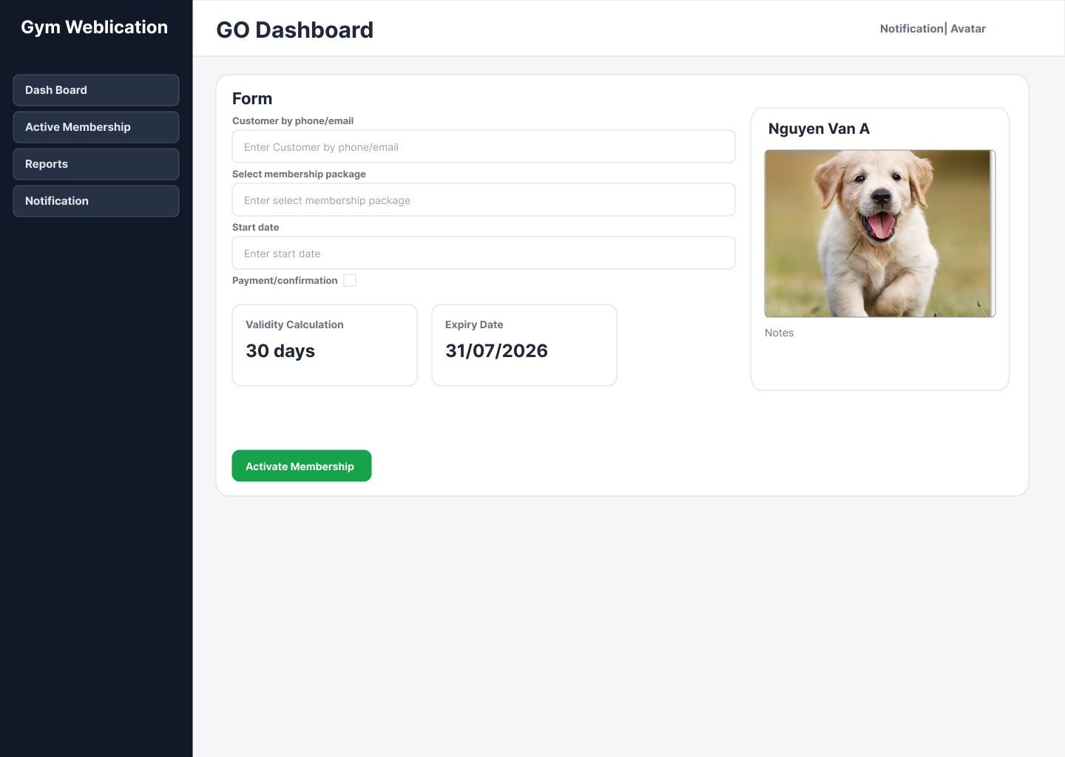
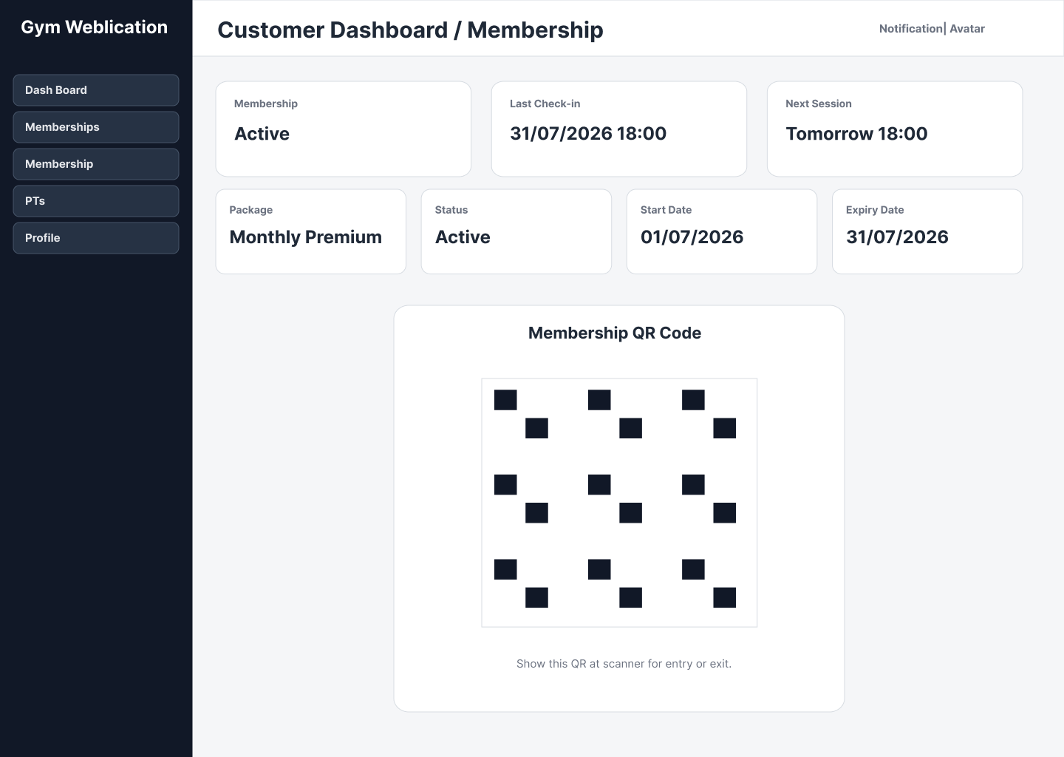
Main Bussiness Process 1
Flow
Customer provides information
Gym Owner selects membership package
System creates CustomerMembership
System activates membership and generates QR
Notification is sent to customer
Key rule: membership is purchased/registered at the counter, not by online payment.
Gym Management System

Slide 9
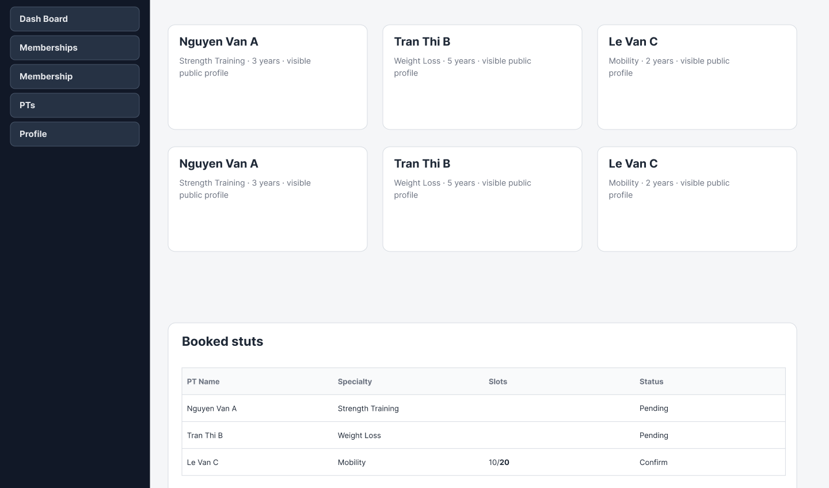
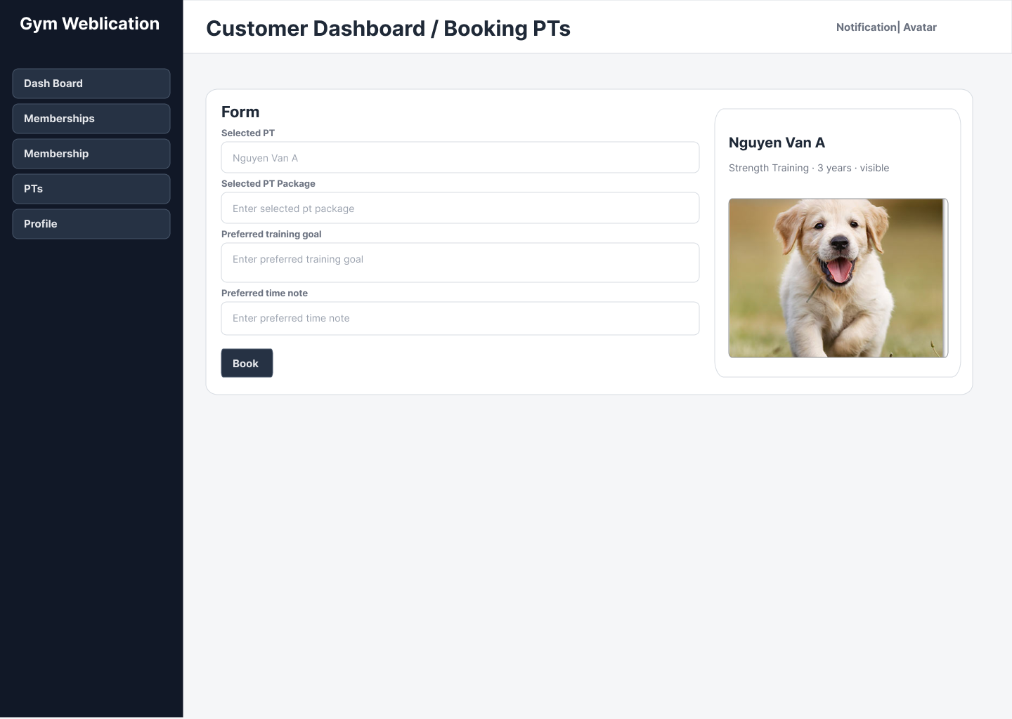
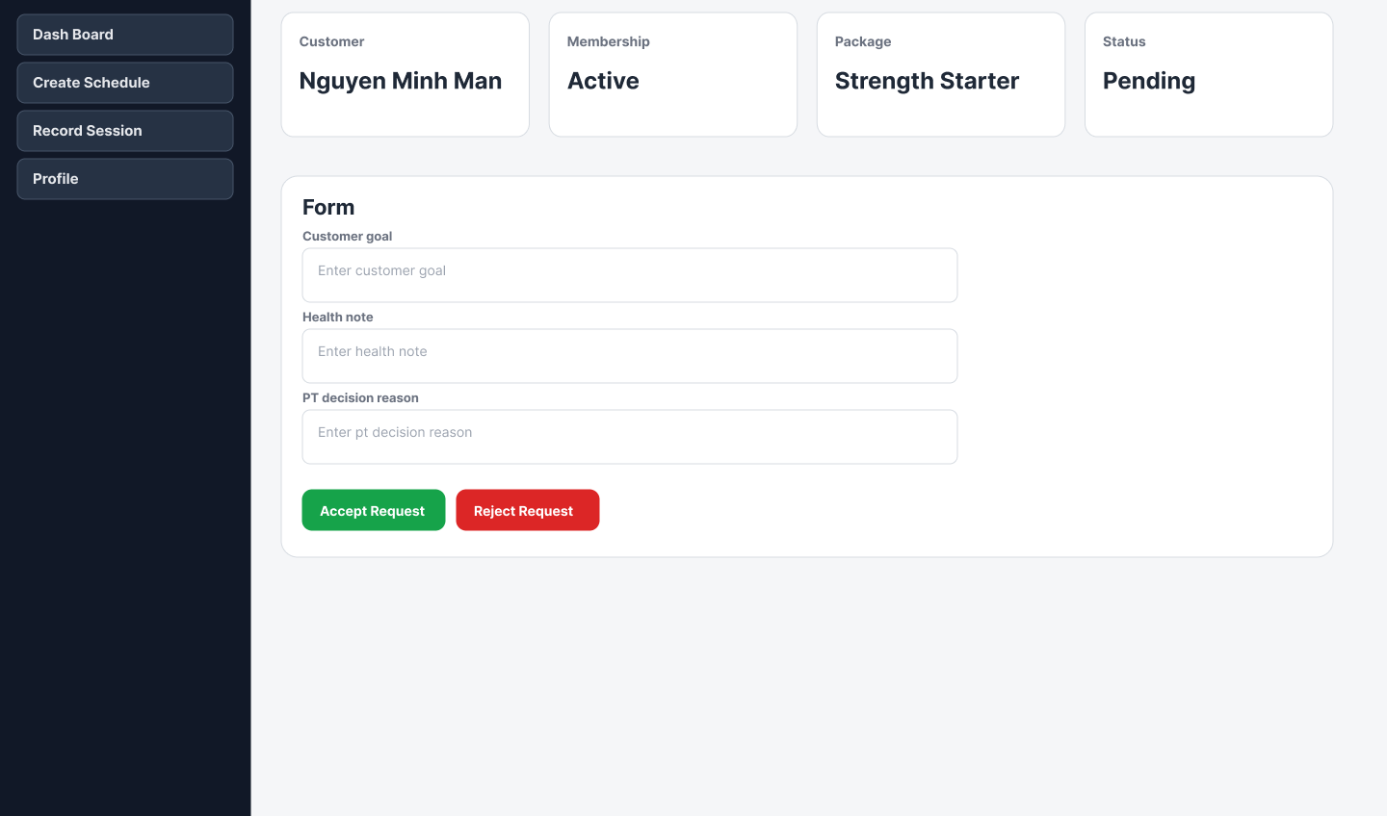
Main Bussiness Process 2
Customer views PTs
Customer books package
PT reviews request
Customer selects PT package
System creates booking request
PT accepts or rejects
System updates booking status
Notification is sent
Result: Confirmed booking can become a training schedule; rejected booking stops the flow.
Gym Management System

Slide 10
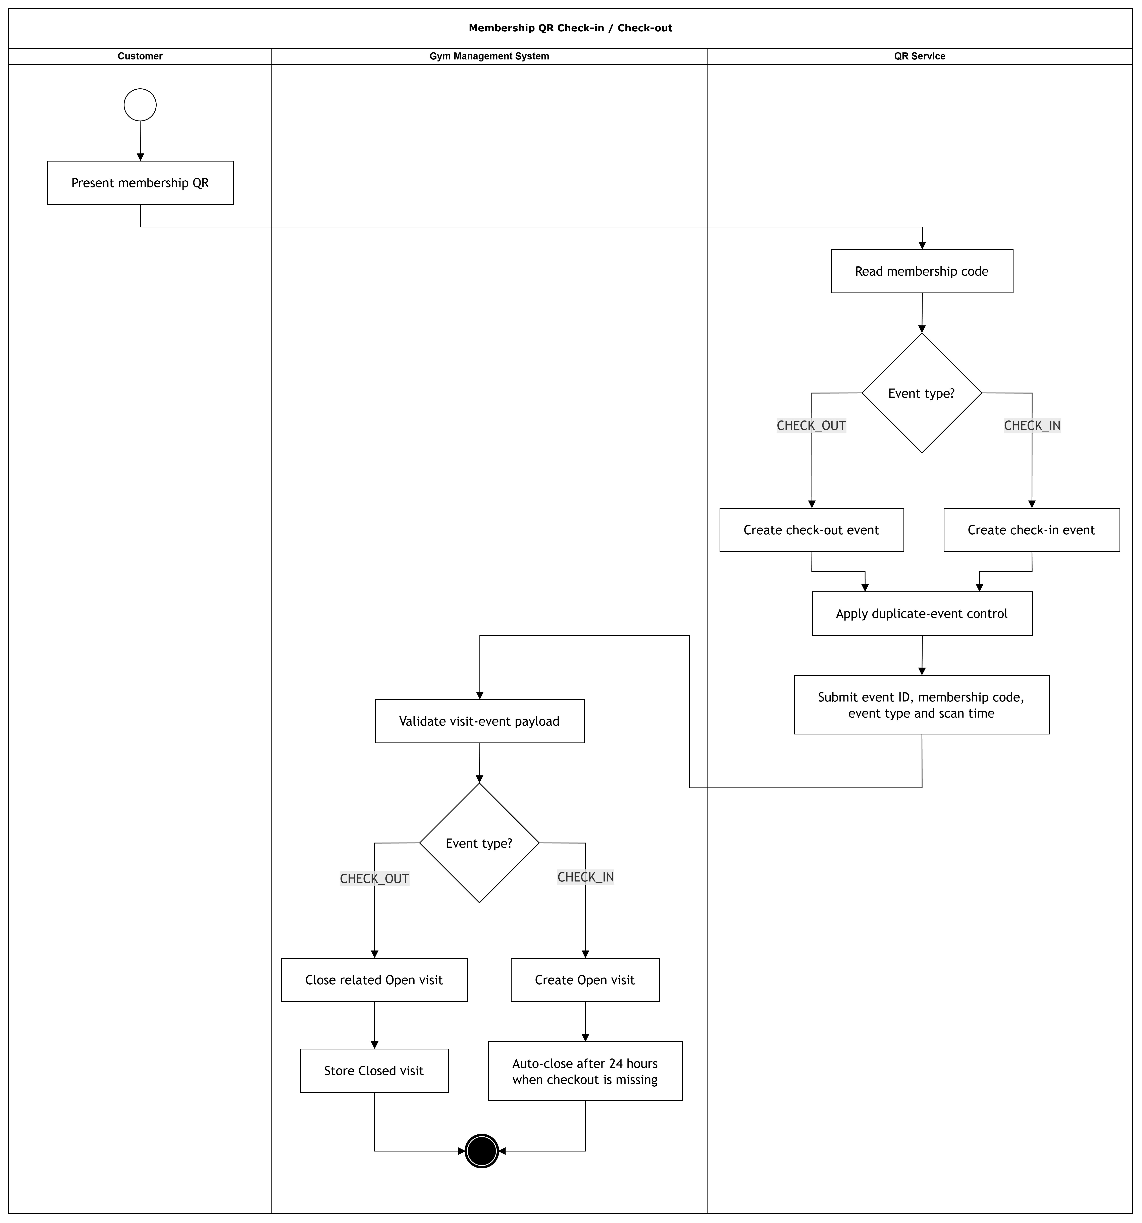
Main Bussiness Process 3
Business rules
QR code exists with the active membership.
QR Scanner sends scan data to the backend.
System validates CustomerMembership status.
Valid scan creates check-in/check-out record.
Gym Owner can view check-in reports.
Access decision depends on membership validity, not payment status.
Swimlane Activity Diagram
Gym Management System

Slide 11
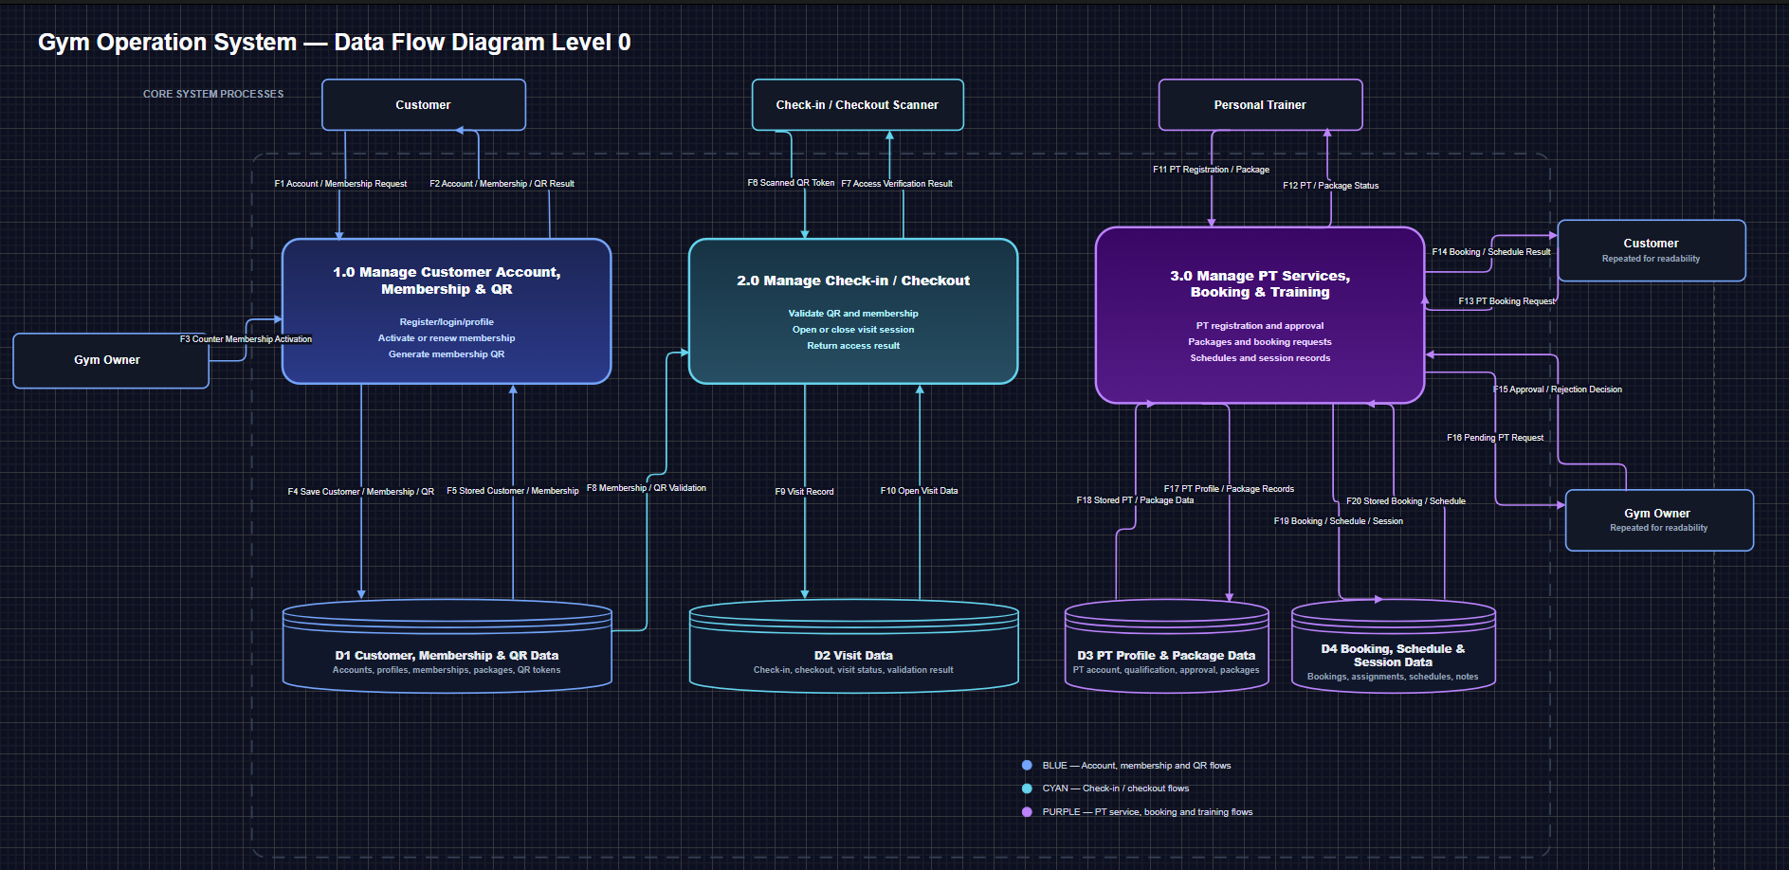
Data flow Diagram Level 0
INSERT OVERALL SYSTEM ARCHITECTURE DIAGRAM
Use the full architecture diagram showing Device Layer, Server Layer, and Application Layer.
Gym Management System

Slide 12
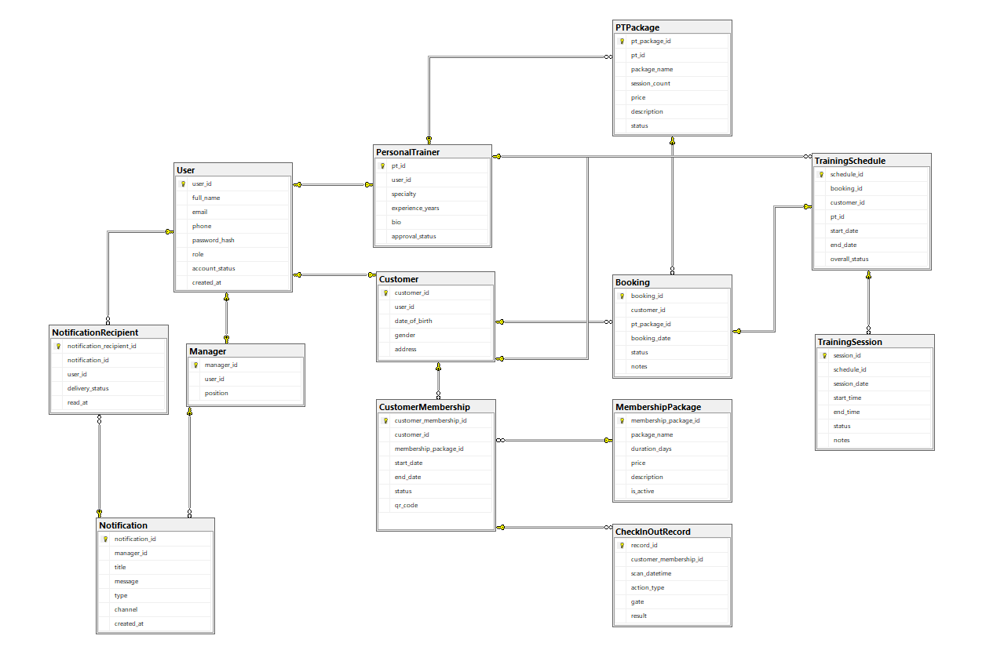
System ERD / Data design
Gym Management System

Slide 13
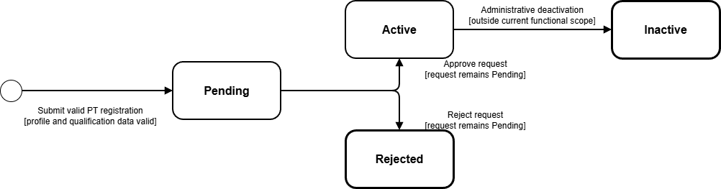
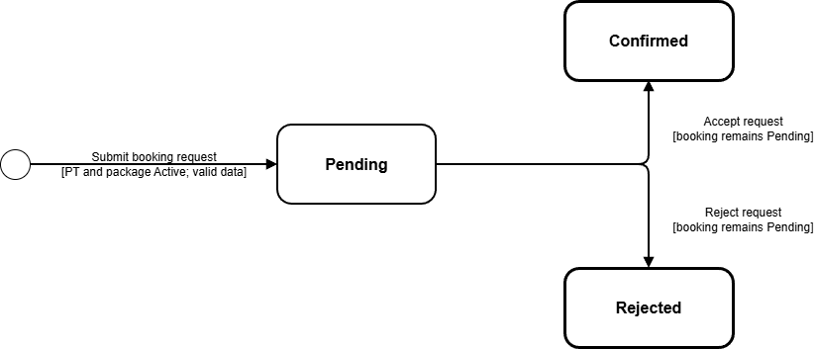
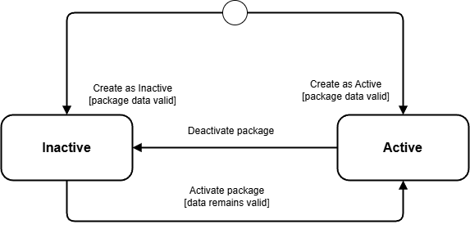
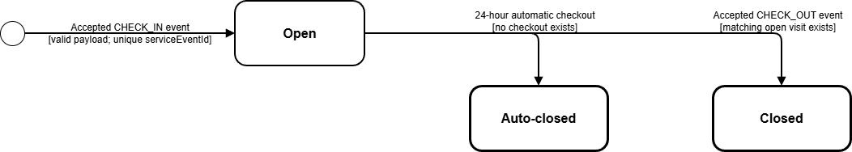
State Transition Diagram
PT Account
Booking
Customer Membership
Visit
Gym Management System

Slide 14
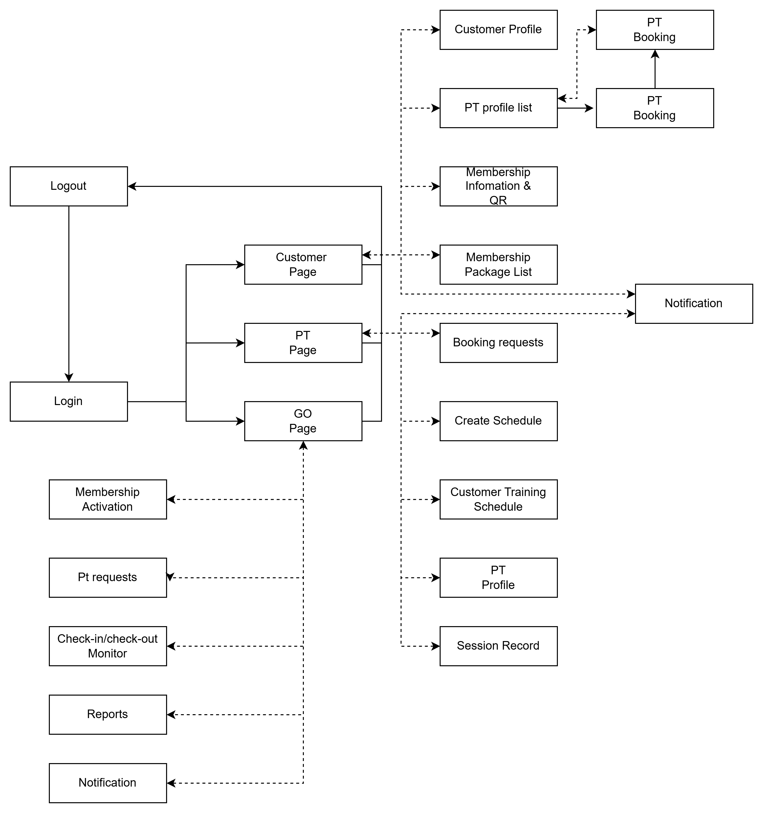
Dialog Map
Gym Management System

Slide 15
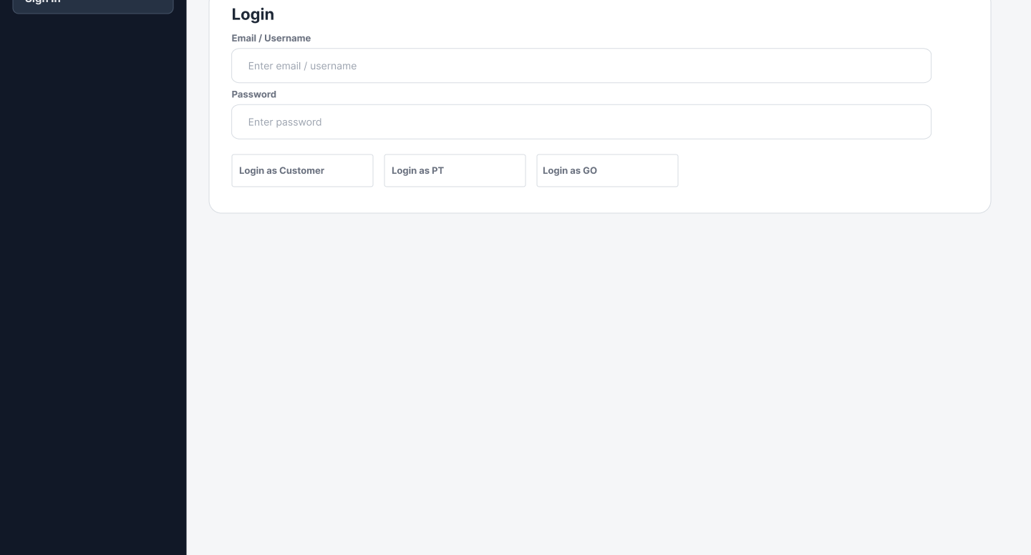
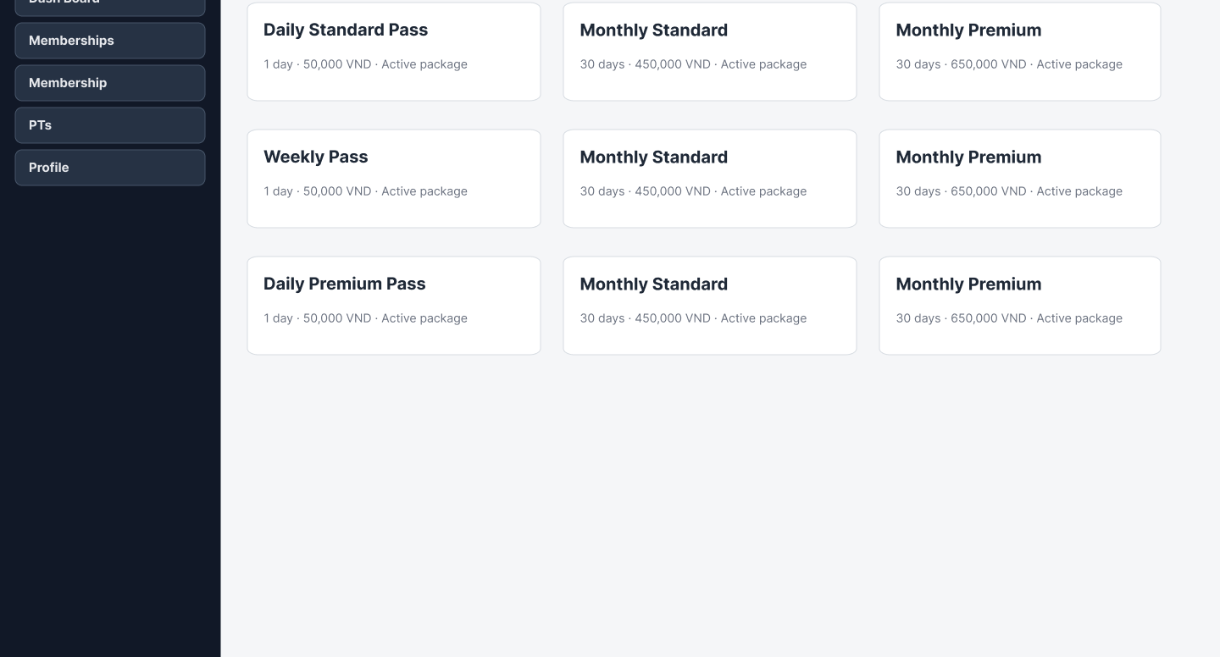
Prototype Demonstrate
1. Login
2. View memberships
3. Book PT package
4. View membership QR
5. View schedule/dashboard
Gym Management System

Slide 16
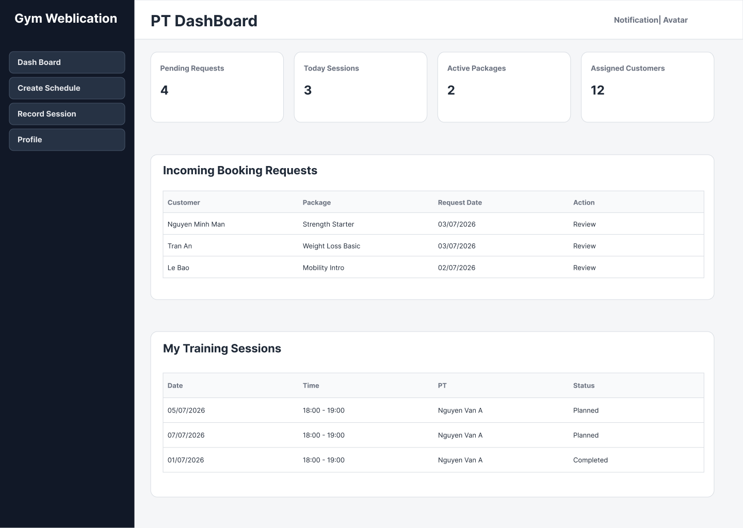
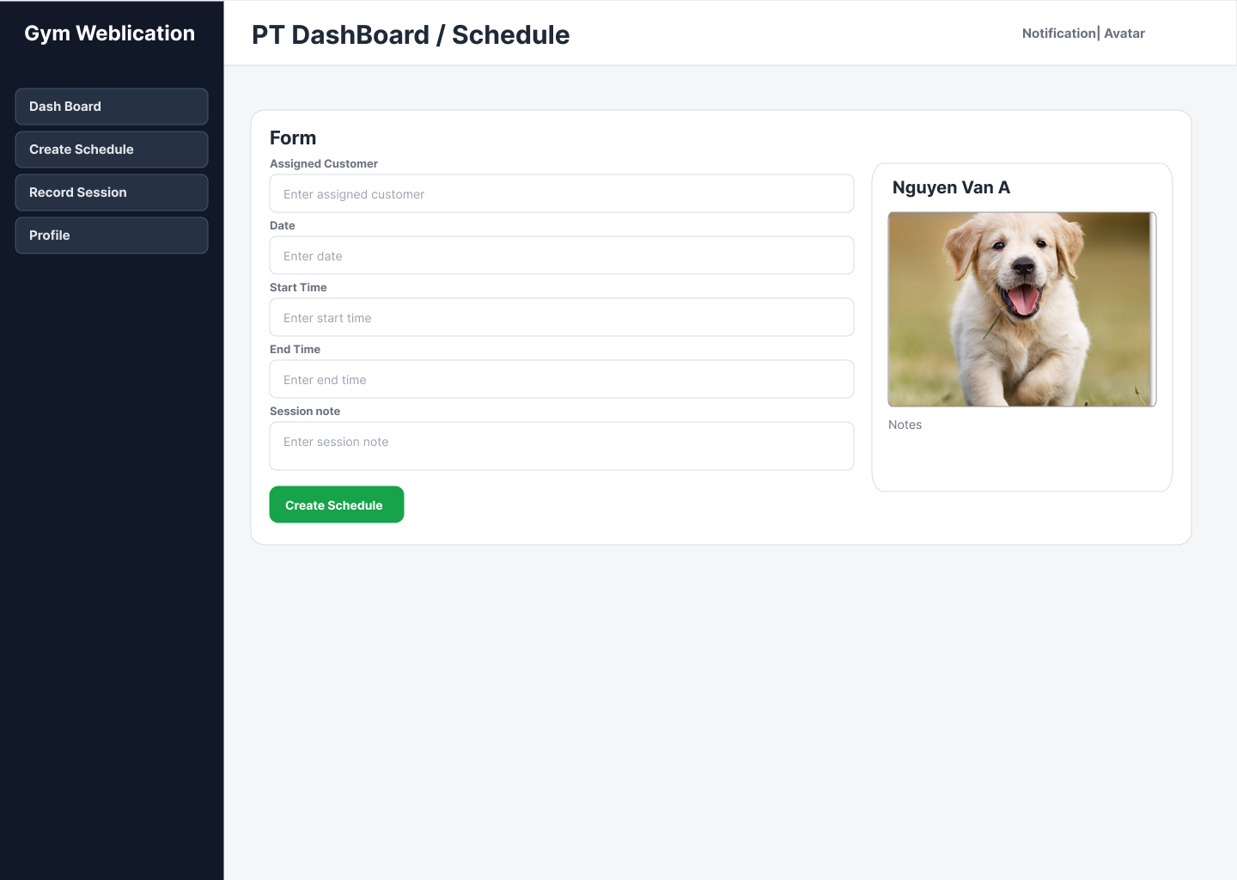
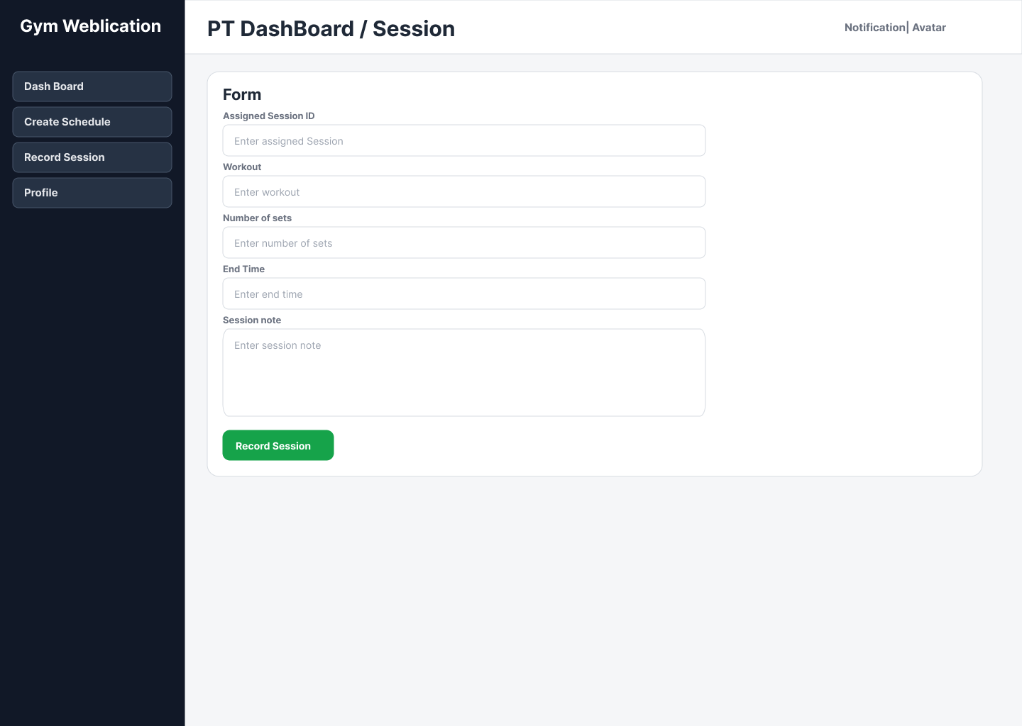
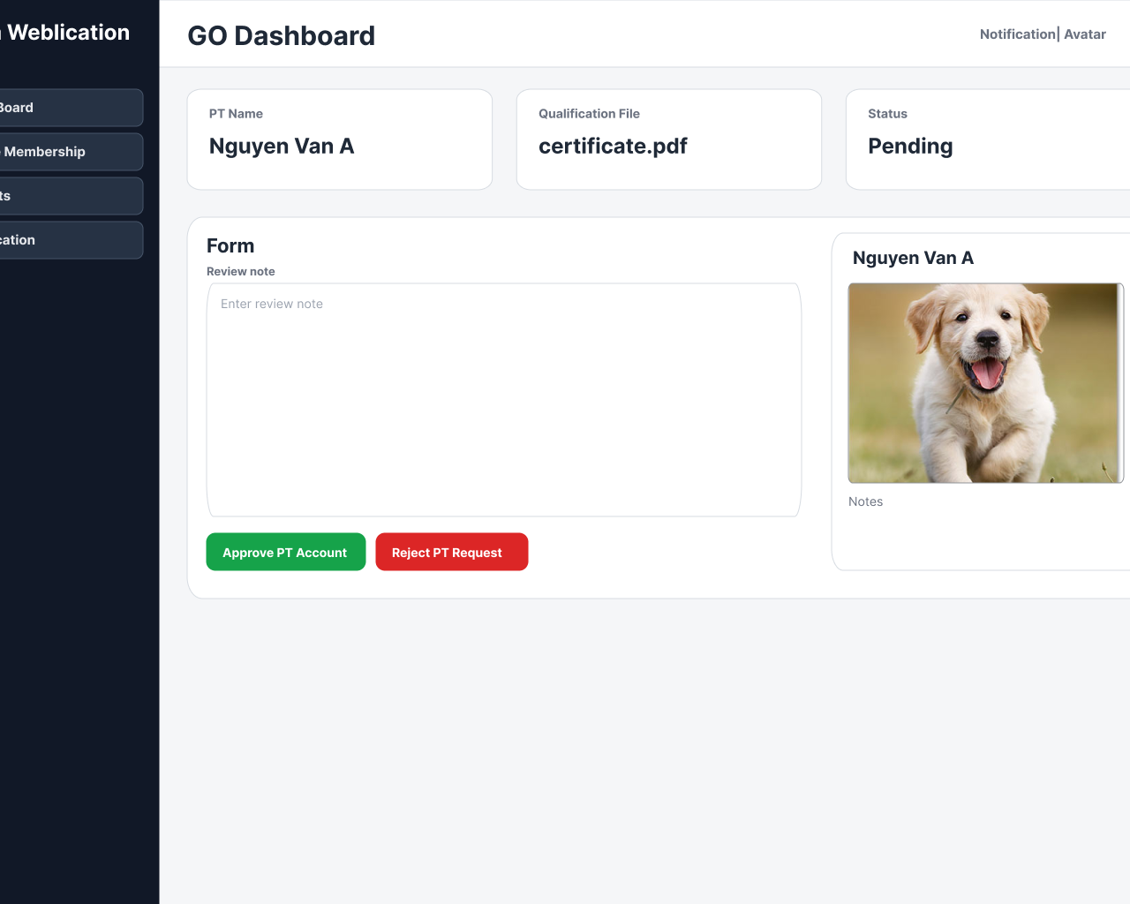
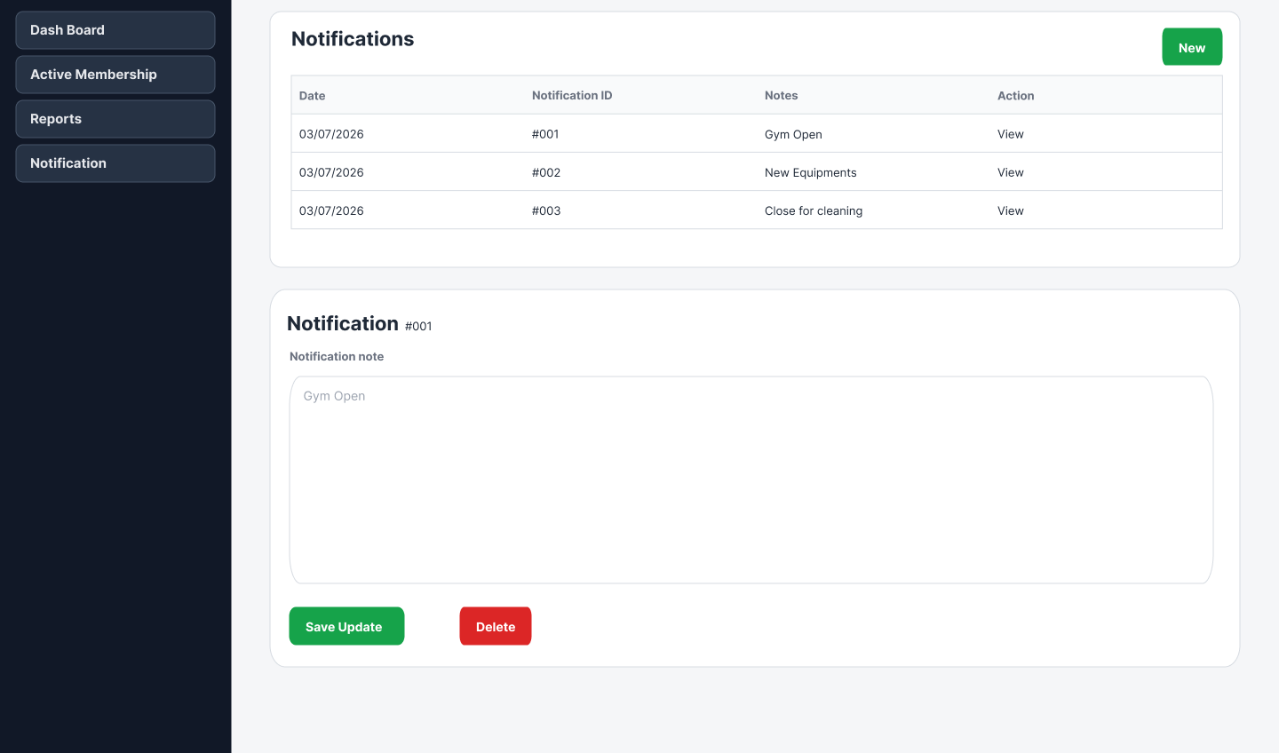
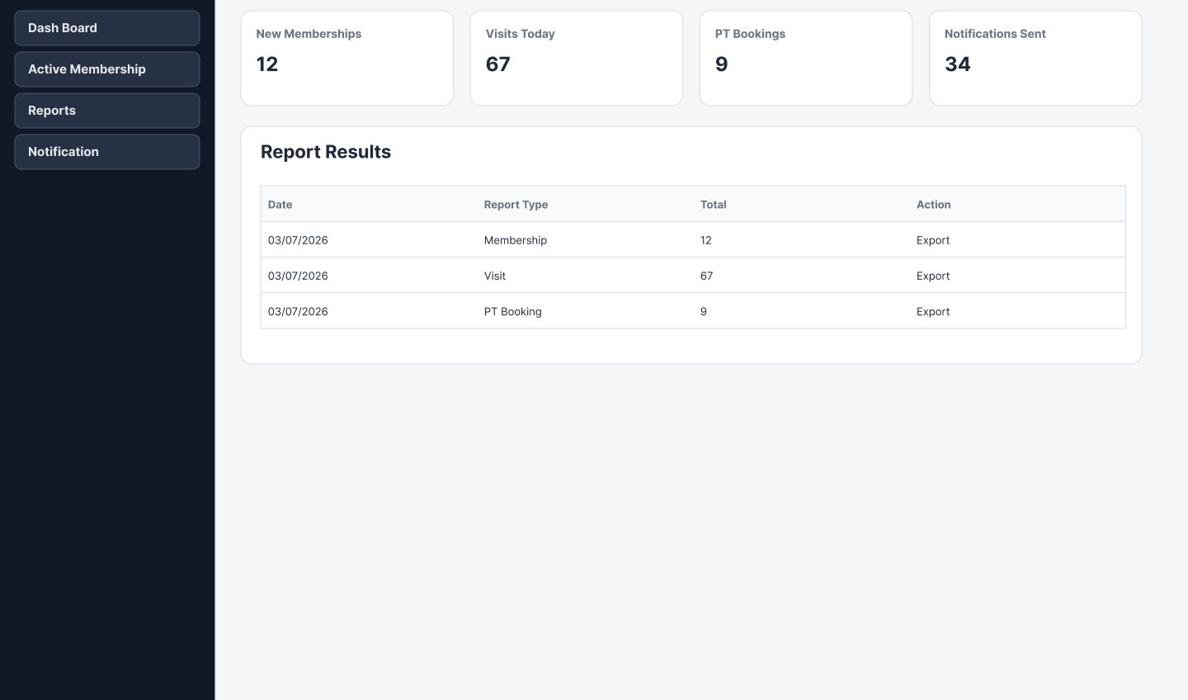
Prototype Demonstrate
PT dashboard
Create schedule
Record session
Approve PT
Activate membership
Publish notification
View reports
Gym Management System

Slide 17
Thanks for listening
Q&A
INSERT PARKING / BARRIER IMAGE
Use a clean image of a parking gate, barrier, or smart parking system.
SWR302 BRD – GROUP 5
Members: Nguyễn Sỹ Minh Mẫn, Trần Đăng Khoa, Bùi Đình Long
Instructor: Trần Chí Viễn
Gym Management System

